Slide 1
Finance AND
RISK

Slide 2
BUSINESS CASE
A portfolio manager makes investment decisions and carries out other related activities on behalf of vested investors. They work with a team of analysts and researchers, and their main objective is to realise the needs of the investor and suggest a suitable portfolio that meets all the expectations. They are responsible for establishing the best investment strategy, selecting appropriate investments along with the right allocation. However, in doing so, they face a lot of competition in the form of other portfolio managers and rival firms. Therefore, the portfolio manager has to use the available resources to provide the best solution to the investor.
Consider yourself working for an associate at an investment firm that manages accounts for private clients. Your role requires you to analyse a portfolio of stocks to provide consultation on investment management based on client’s requirement.

Slide 3
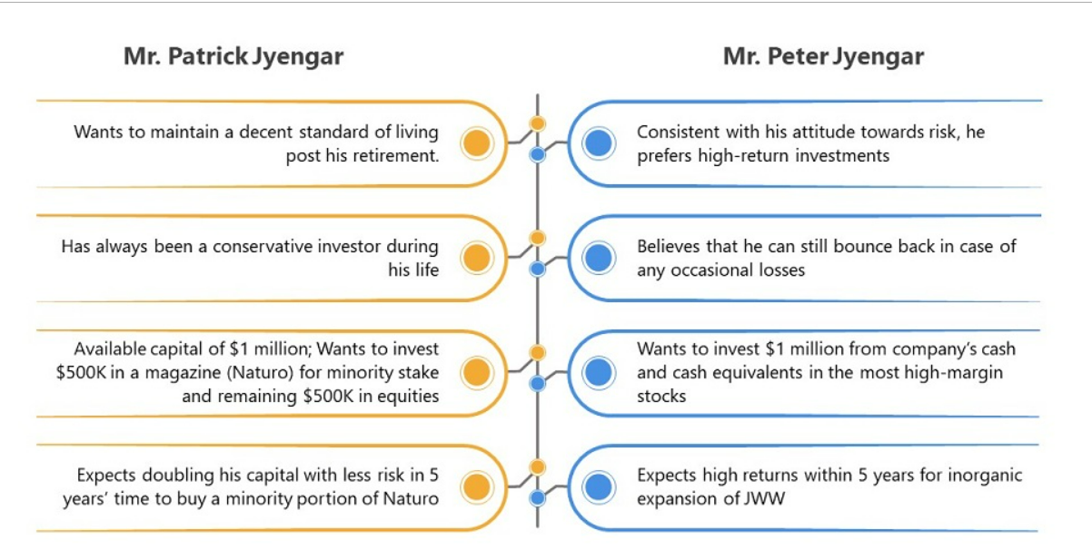
Your task is to provide consultation to two different investors, Mr Patrick Jyenger and Mr Peter Jyenger based on their requirements and financial objectives. You can refer to the elements mentioned in the video to develop the investor persona. The image below summarizes the profile of the two investors:
You must perform the required steps for both the individuals after understanding the investor persona independently.

Slide 4
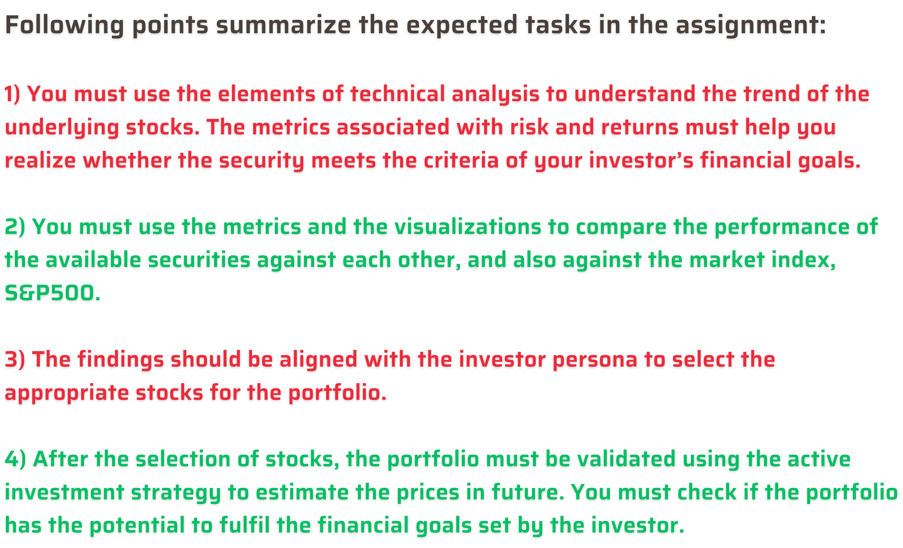

Slide 5
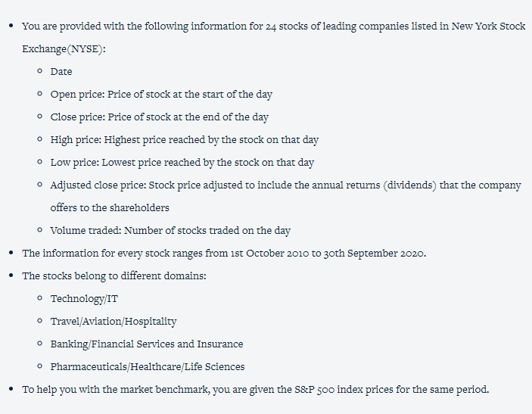
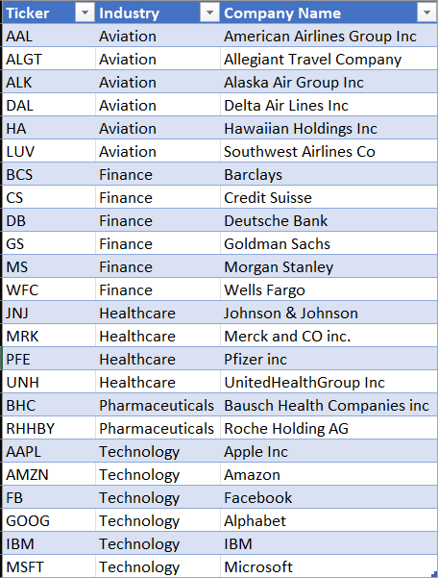
DATA DESCRIPTION

Slide 6


APPROACH
The entire capstone can be divided into the following aspects:
Preliminary Steps - Data loading Data Exploration
Stock Analysis and Portfolio
Management Reporting

Slide 7
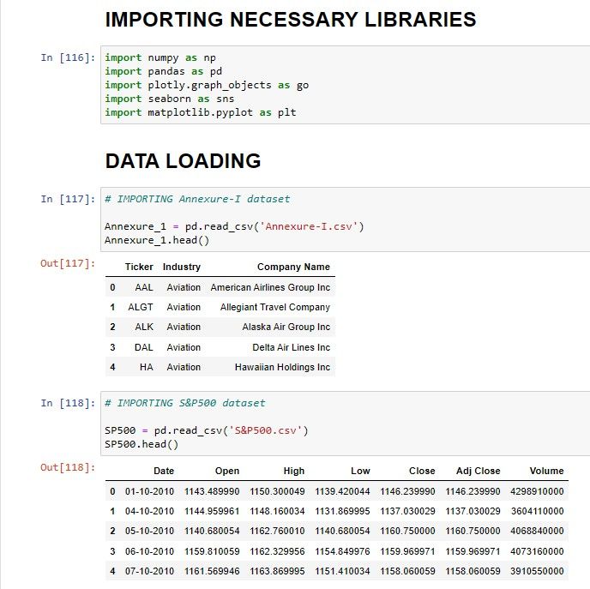
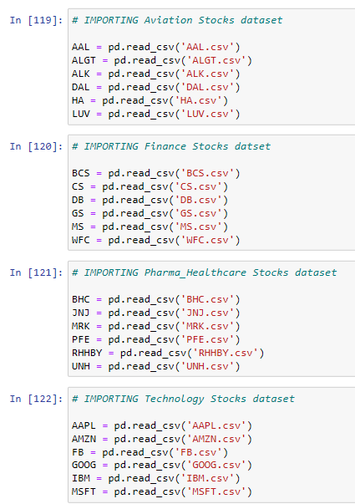
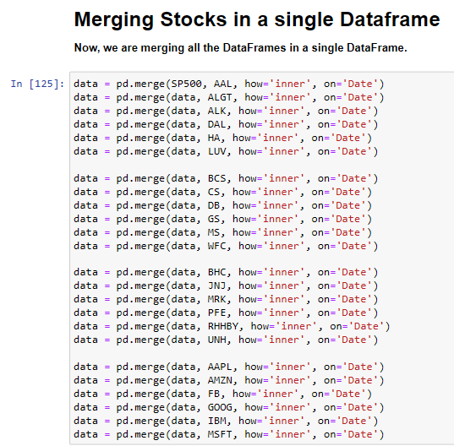
PRELIMINARY STEPS
Under preliminary steps, you are expected to load the entire data into the working environment (Python). The entire data must be merged into a single data frame with only the required columns.

Slide 8
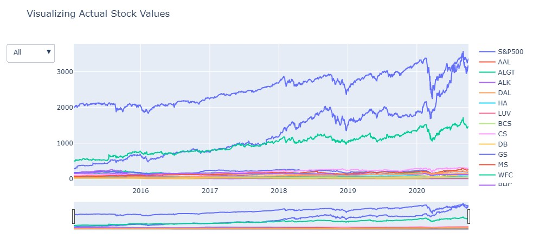
DATA EXPLORATION
FROM THE ABOVE VISUALIZATION IT CAN BE DETERMINED THAT AMAZON AND GOOGLE HAVE A UPWARD TREND.

Slide 9
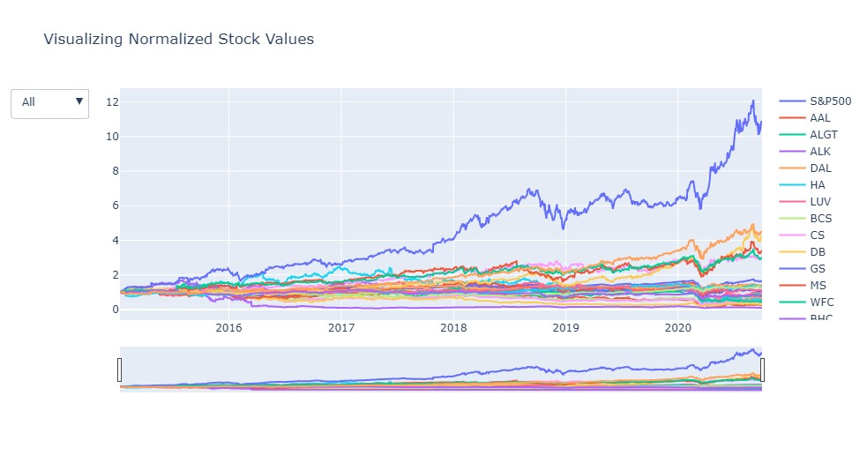
FROM THE NORMALIZED STOCKS ABOVE, IT CAN BE OBSERVED THAT THERE ARE QUITE A FEW STOCKS WHICH ARE PERFORMING BETTER THAN S&P500.

Slide 10
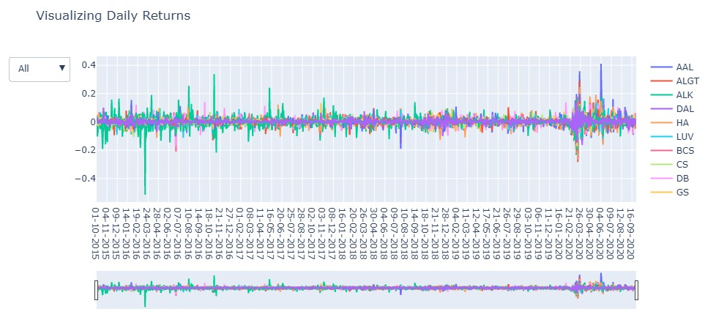

Slide 11
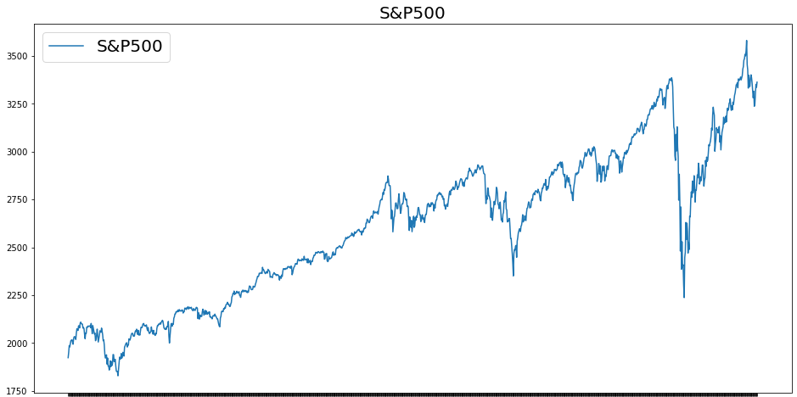
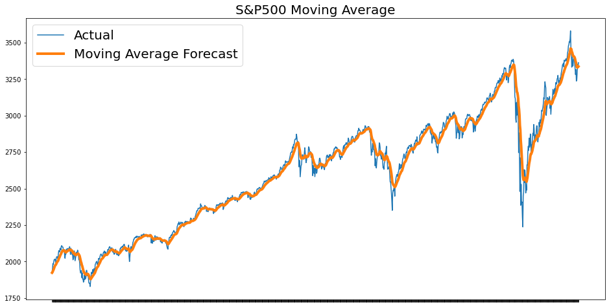

Slide 12
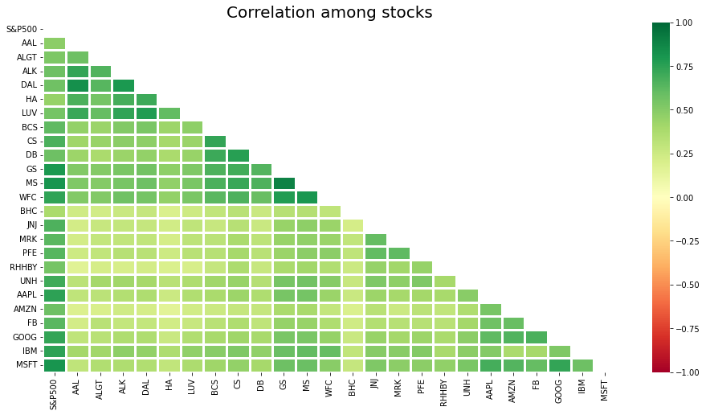

Slide 13
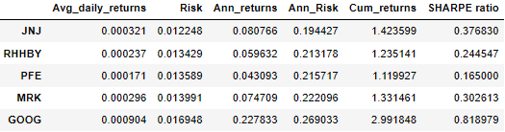
A. MR. PATRICK JYENGER
BASED ON THE PORTFOLIO OF MR. PATRICK JYENGAR, HIS REQUIREMENTS ARE LOW RISK AND DOUBLE RETURNS.
BELOW ARE THE 5 STOCKS WITH THE LOWEST RISK:
Portfolio Returns = 1138766.0026862654 and Portfolio Risk= 0.21135455866092662
The estimated portfolio returns for the stocks JNJ, RHHBY, PFE and MRK is $1,138,766 with 21.13% risk which is near to the market or S&P500 risk.**
Therefore, we recommend Mr.Patrick Jyenger to invest the amount in the below stocks equally to get 2.4X returns with a 21% risk .
Johnson&Johnson
Roche Holding AG
Pfizer Inc
Merck and CO inc.
Google

Slide 14
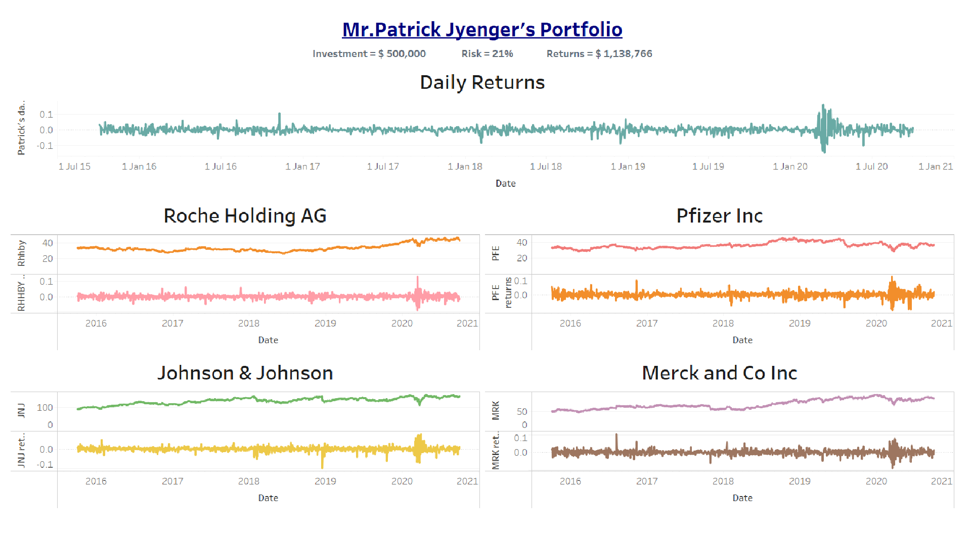

Slide 15
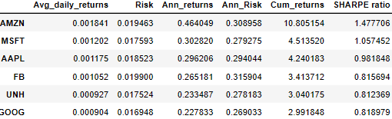
B. MR. PETER JYENGER
BASED ON THE PORTFOLIO OF MR. PETER JYENGAR, HIS REQUIREMENTS ARE HIGH RETURNS WITH ANY RISK.
BELOW ARE THE 6 STOCKS WITH THE HIGHEST RETURNS:
Portfolio Returns = 5834098.664257467 and Portfolio Risk= 0.29089961099929895
The estimated portfolio returns for the stocks AMZN, MSFT, AAPL, FB, UNH, GOOG are $5,834,098 which is 4 times the investment with a risk of 29%.
Therefore, we recommend Mr. Peter Jyenger to invest in the below stocks to get a 4X return with a 29% risk:
Amazon
Google
Microsoft
Apple
Facebook
United Health group Inc

Slide 16
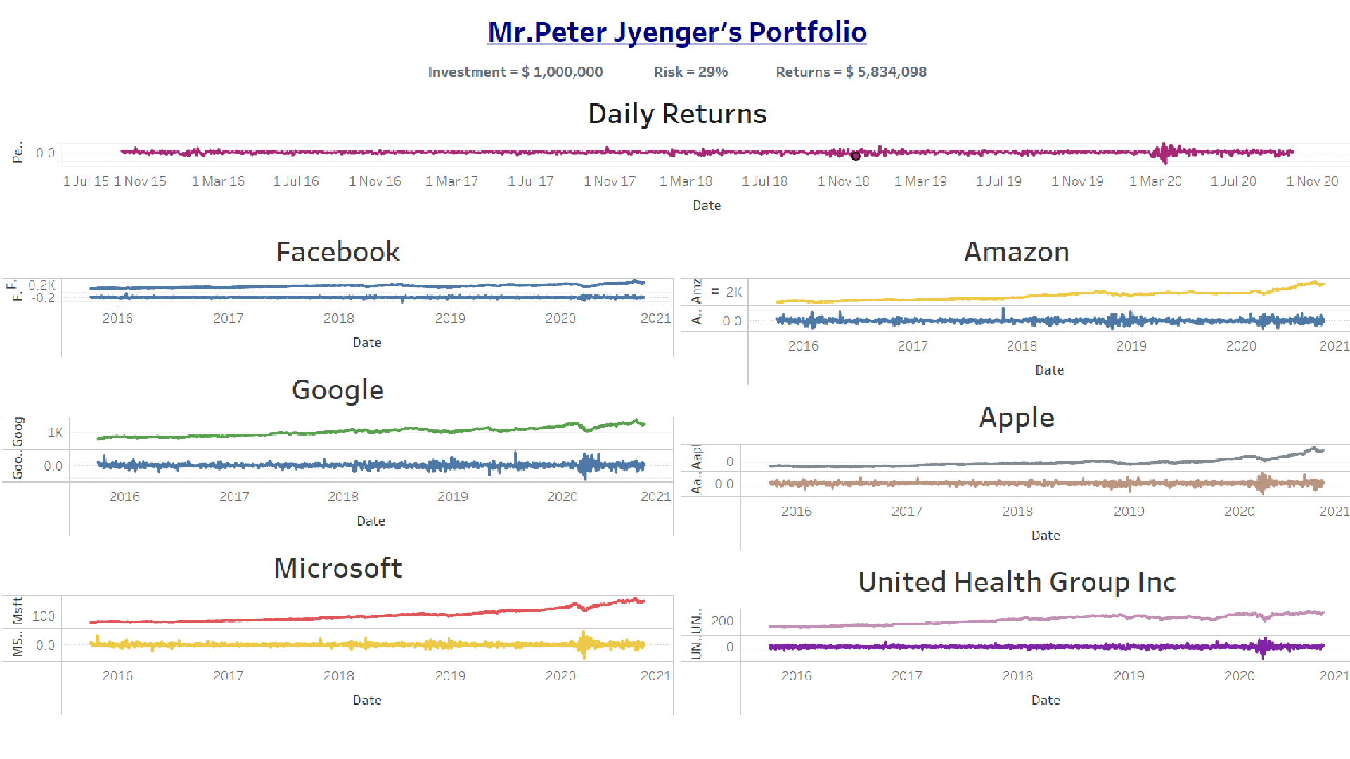

Slide 17



THANK YOU

